Slide 1
Potential Flow Solutions
Jennifer Yang
June 21, 2021

Slide 2
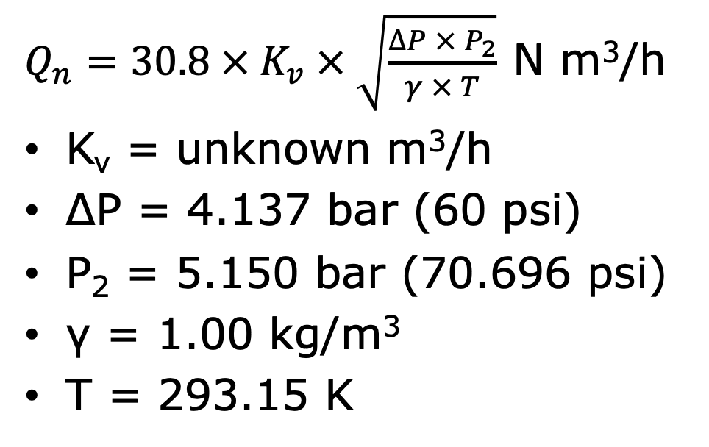
Current Flow Information
Assumptions:
20 degrees Celsius
Starting at atmospheric pressure (1 atm)
Pressure change of 60 psi
Subsonic air flow
$Q_{n}=30.8 × K_{v} × \sqrt{\frac{∆P × P_{2}}{γ × T}}$ N m³/h
K_{v} = unknown m³/h
ΔP = 4.137 bar (60 psi)
P₂ = 5.150 bar (70.696 psi)
γ = 1.00 kg/m³
T = 293.15 K
Notes:
Source: https://tameson.com/flow-principles.html
https://tameson.com/solenoid-valve-types.html
Overall Assumptions:
20 degrees Celsius
Assuming room temperature which standardly is 20 degrees Celsius
Starting at atmospheric pressure (1 atm)
Pressure change of 60 psi
Subsonic air flow
The initial pressure was less than half the pressure change as noted here
Equation on the right
Nm^3/h = normal cubic meters per hour
Mostly kept this for reference
Wanted to use it to find the current flow rate
Realized that did not know Kv (flow coefficient)
Thought it could potentially be useful for a situation where we know more information about the valve

Slide 3
Inserts
3D print assorted inserts to change the orifice to restrict flow rate
Issue: Keeping the insert in there nonpermanently
Potential Solution: Use a set screw
Allows for multiple possible diameters for the orifices without having to purchase a new valve
May not be secure enough to stay in the opening
Could affect the outside threads of the product
Notes:
3D print assorted inserts to change the orifice to restrict flow rate
Issue: Keeping the insert in there nonpermanently
Potential Solution: Use a set screw
Allows for multiple possible diameters for the orifices without having to purchase a new valve
May not be secure enough to stay in the opening
Could affect the outside threads of the product
Overall thoughts
Could potentially be an option and might be the best for experimenting with flow rates without having to buy something new but need to consider when the cost and time of printing is going to be less worthwhile than either changing the setup or finding a coding solution
Set screws might not be the best option but that’s my default for nonpermanent attachment methods
Something more secure would be epoxy or glue but that is a permanent attachment and harder to go back and forth on

Slide 4
Needle Valves
Additional flow control valve to slow the flow rate and therefore the actuator speed
Regulates air flow into the system and allows gradual adjustment to fine tune
Would help us figure out what flow rate we should work with to better control the arm movement
Issue: Would require purchasing more parts could affect the setup and functionality long term
Notes:
https://tameson.com/needle-valve.html
Additional flow control valve to slow the flow rate and therefore the actuator speed
Regulates air flow into the system and allows gradual adjustment to fine tune
Would help us figure out what flow rate we should work with to better control the arm movement
Issue: Would require purchasing more parts could affect the setup and functionality long term
Basically we would have to add another section where each of the tubes have one of these inbetween
It would help us with the flow rate testing but adding this section might influence the movement
Based on past video in the discord, the setup looks kinda bulky and adding this would bring more bulk to the system
Also cost: not sure how much it would cost to buy one that is compatible or if it is even worth it

Slide 5
Proportional Solenoid
Valve that varies flow passage size using a restrictor
Standardly uses a range of valve positioning rather than the two state on/off
Would allow us to experiment with more flow rates
Issue: Would have to buy new valves and change the system (current valves would not be used)
Notes:
https://tameson.com/proportional-solenoid-control-valve.html
Valve that varies flow passage size using a restrictor
Standardly uses a range of valve positioning rather than the two state on/off
Would allow us to experiment with more flow rates
Issue: Would have to buy new valves and change the system (current valves would not be used)
Similar concerns as the previous one except instead of adding to the system, we would be replacing a part of the system which would make the thing less bulky than adding one
Could still affect the movement
Also unsure of how much it costs to get some of these

Slide 6
PWM Solution
Experiment with more duty cycles
Issues:
May change the time it takes to inflate overall but does not eliminate the issue with the jumpy motion
Still difficult to control the dynamics of the model
Notes:
Experiment with more duty cycles
Issues:
May change the time it takes to inflate overall but does not eliminate the issue with the jumpy motion
Still difficult to control the dynamics of the model
We might be able to find out more information about how the robot moves with lower duty cycles but it doesn’t fully solve the problem
I can’t think of any other controls solutions

